Slide 1

Digging into Crime in Los Angeles
Group 12: True Detectives
Akhil Aenugu, Collin Marcian, Jainam Chhadwa, Jasmit Singh Gill, Navida Nandakumar, Nishok Ilangovan, Sandeepkumar Vijaya Kumar, Shriya Natta

Slide 2
TABLE OF CONTENTS
Introduction
Data Processing
Data Analysis
Recommendations
01
02
03
04

Slide 3
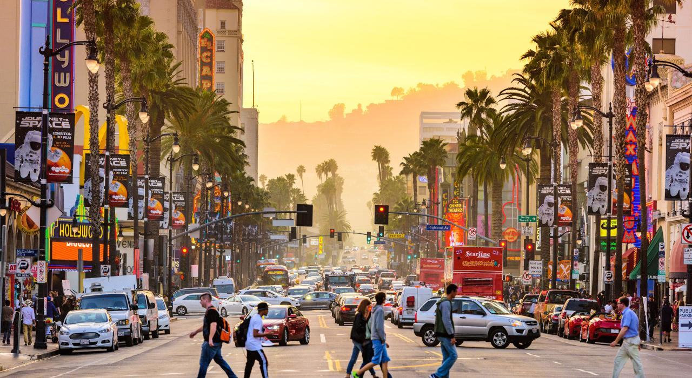
Introduction
01

Slide 4
Why LA Crime?
High Spending
Minimal Results
California incurs major costs policing and correcting the crime rate in LA
The expected decrease in crime rates has not materialized as anticipated.
LA’s crime index is in the top 10% nationwide
LA’s Violent Crime rate is 3.4 points above the national average
Notes:
https://www.neighborhoodscout.com/ca/los-angeles/crime

Slide 5




Expected Findings
Geospatial Analysis
Premises Analysis
Time Series Analysis
Crime Prediction
Are there specific areas that are prone to crimes?
Do specific crimes occur in particular types of locations?
How has the overall crime rate shifted over the years?
Are there any long-term patterns or trends?
Is it possible to predict future shifts in crime rate?

Slide 6
Data Sets
Los Angeles Crime Data
LA Crime Data: 2010-2023
LA Grant Funding
Premises Data
Crime Occurrence Details
Grand Funding Dates
Schools Locations
Victim Demographics
Type of Grants
Shopping Malls Location
Location Details
Agency Description

Slide 7

Data Processing
02

Slide 8
Data Processing Steps
Data Cleaning
Geospatial Preparation
Victim Age, Gender, & Descent
Group area names with incidentals
Incident Location & Time
Join GeoJson file
01
02
03
04
Merging Data
Sets
Data Transformation
LA 2010-2019 +
LA 2020-2023
Date, Time, Latitude, Longitude

Slide 9
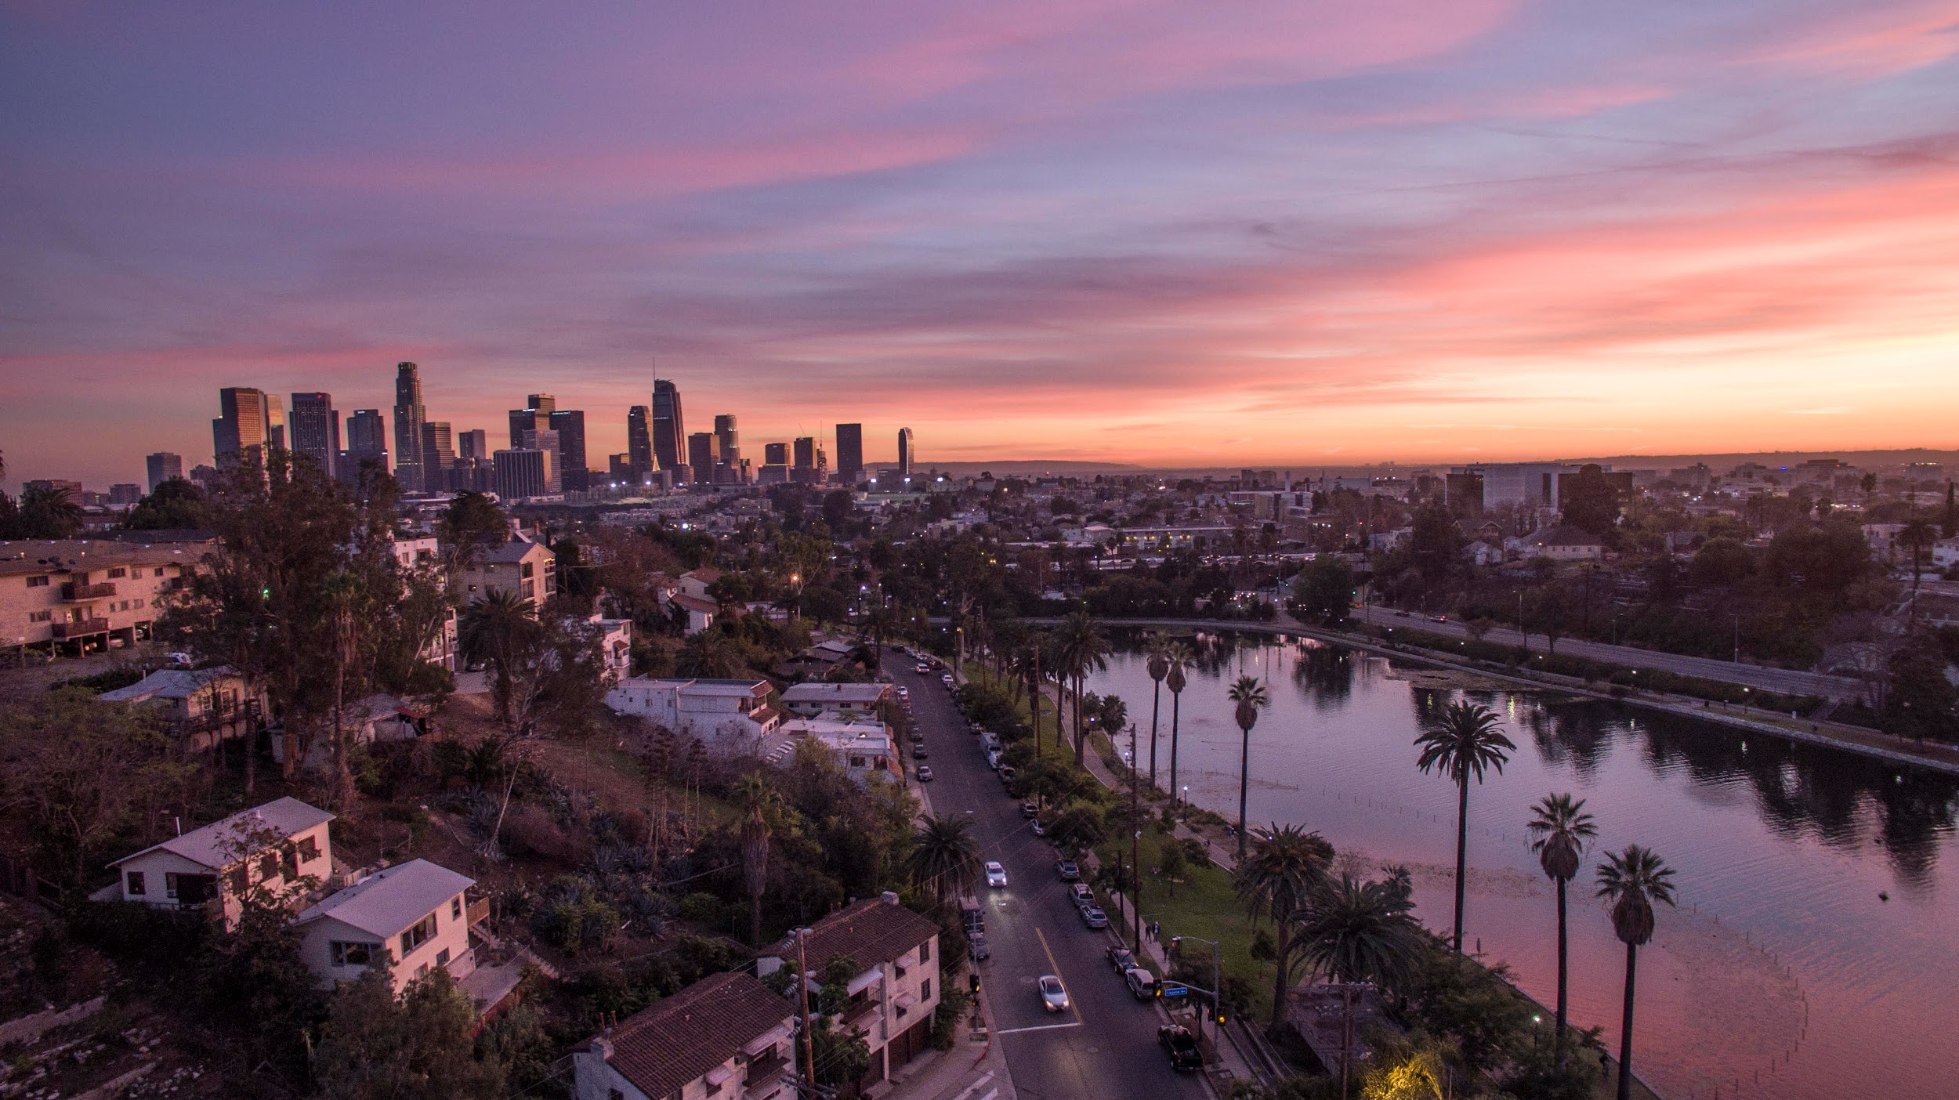
Data Analysis
03

Slide 10
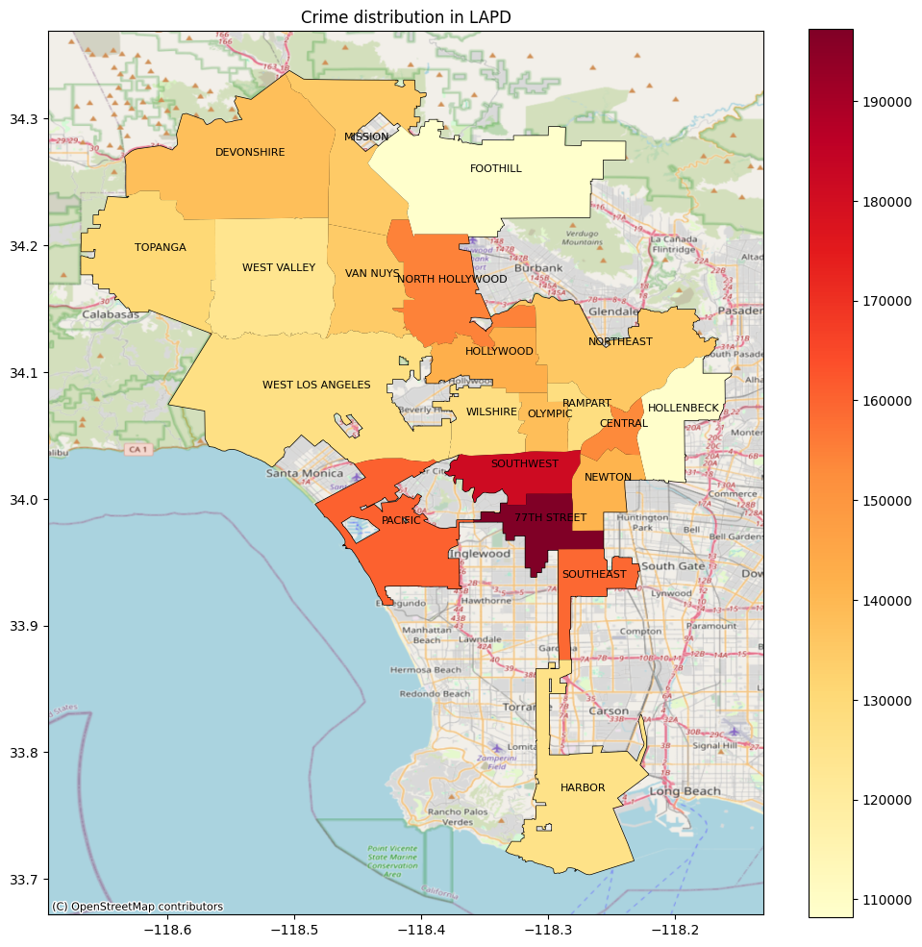
Geospatial Analysis
Inferences
Crime Hotspots
77th Street, Southwest, Pacific, Southeast, North Hollywood
Divisions with High Crime Concentration
Central → Battery & Assault
77th → Vehicle Theft
Pacific → Theft & Burglary

Slide 11
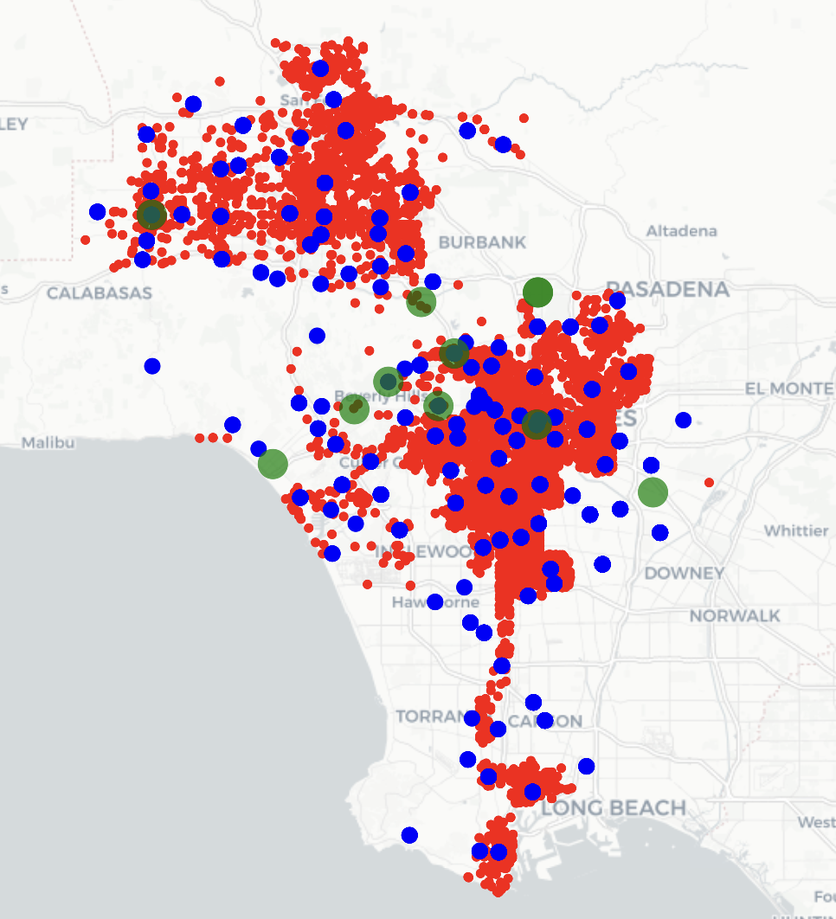
Premises Analysis
: Malls : Schools : Crime Incidents
UNIQUE IDENTIFIER | TAKEAWAYS
SCHOOLS | Clear pattern of firearm related crime
MALLS | Exercise caution in “hotspot malls” due to a higher incidence of gun-related incidents
DOWNTOWN LA | Rare explosive device-related crimes centered in Downtown LA
VENICE BEACH | Crimes involving knives and axes are prominent

Slide 12
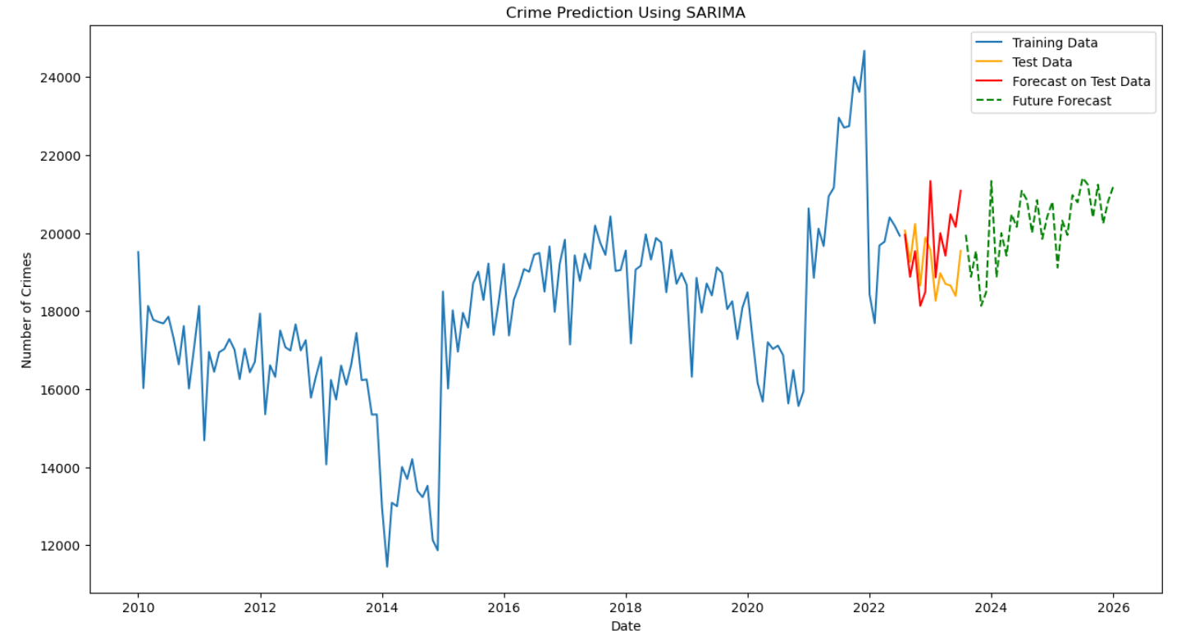
Crime Prediction Model

Slide 13
Crime Prediction Applications
Budget Planning
Community Trust
Evaluation of Interventions
Accurate predictions will ensure funds are allocated where they are needed most.
Transparency in sharing crime predictions can illustrate proactive steps are taken to mitigate crime.
The effectiveness of law enforcement and crime prevention strategies will be evaluated in contrast with the model

Slide 14
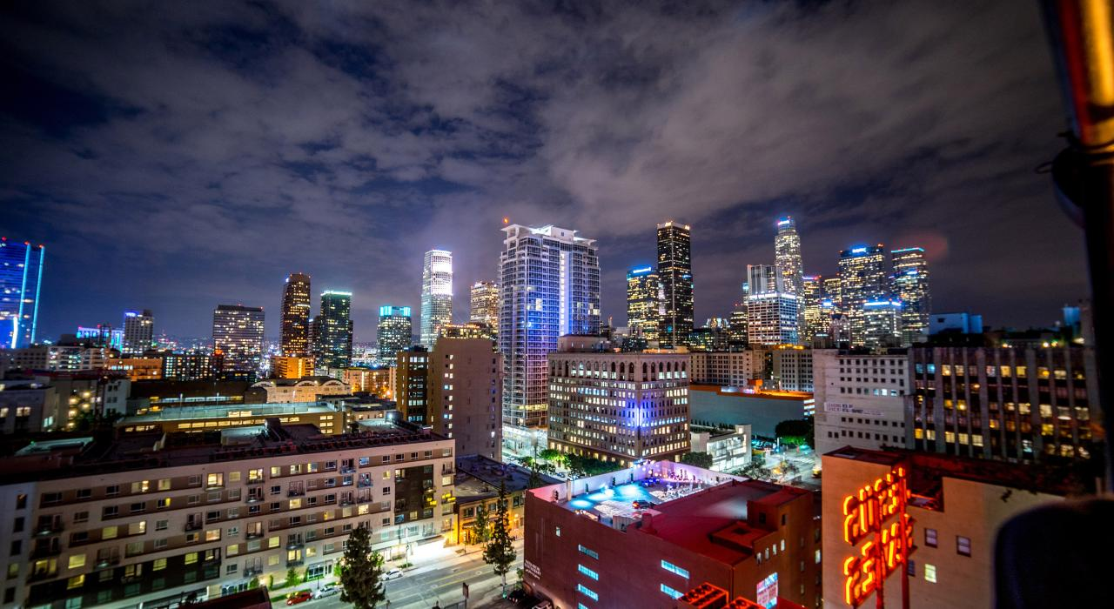
Recommendations
04

Slide 15



Analysis-Based Recommendations
Geospatial Analysis
Premise Analysis
Crime Prediction Analysis
Increasing patrolling in the South LA Region
Implement proactive policing strategies in school and mall areas to enhance community safety.
Propose a budget increase for LAPD in response to the rising trend in predicted crime numbers.

Slide 16
Division Specific Recommendations
Central Division
77th Street Division
Pacific Division
Enhance community-police partnerships and programs
Emphasize vigilance against theft and burglary
Collaboration with automobile manufacturers to address vehicle vulnerabilities
Public awareness about securing vehicles
Strengthen community watch programs
Foster community awareness for safeguarding homes and personal belongings.

Slide 17
Questions?
Group 12: True Detectives
Akhil Aenugu, Collin Marcian, Jainam Chhadwa, Jasmit Singh Gill, Navida Nandakumar, Nishok Ilangovan, Sandeepkumar Vijaya Kumar, Shriya Natta

